Slide 1
/Nithya/English/school

Slide 2
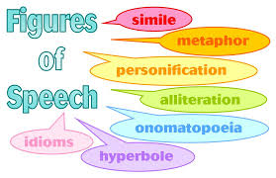

Slide 4
/Nithya/English/school
/Nithya/English/school

Slide 5
/Nithya/English/school

Slide 11
